Slide 1
Capstone: Find the best neighborhood in Toronto to open apply government incentives to urban development

Slide 2
Introduction: Business Problem
The government of Toronto has funded a project to incentivise commercial areas in order to stimulate urban development in underdeveloped comercial regions, with the first sector to receive the stimulus being the restaurant sector.
In order to find said restaurants with the need for said stimulus we must search for areas which are secluded and have a poor saturation of this sector of commerce.
We will use data science to analyse data and focus on the least populous and explore its neighborhoods and find the most eligible venues in each neighborhood so that the best neighborhood can receive the stimulus.

Slide 3
Data
1. List of Toronto neighborhoods broken down by postal code.
to find which are the existing neighborhoods in toronto
https://en.wikipedia.org/wiki/List_of_postal_codes_of_Canada:_M
2.Toronto neighborhoods populations
to find the least populous
https://www12.statcan.gc.ca/census-recensement/2016/dp-pd/hlt-fst/pd-pl/Tables/File.cfm?T=1201&SR=1&RPP=9999&PR=0&CMA=0&CSD=0&S=22&O=A&Lang=Eng&OFT=CSV
3.list of all Restaurant Venues from all neighborhoods in Toronto
to find the venues
https://api.foursquare.com

Slide 4
Data managing
1. Read data
read the data from the List of Toronto neighborhoods and Toronto neighborhoods populations
2. Merge data
merge List of Toronto neighborhoods with geographic information and Toronto neighborhoods populations
3. Venues data
get the data from venues in toronto with the 4SQUARE API, then select only venue related to restaurants
4. Prepare data
prepare the data for clustering process

Slide 5
Methodology
Clustering
The clustering method used was K-means. The K-means method is a classic data mining and signal processing algorithm, with the purpose of iteratively partitioning n observations in k clusters in which each observation has a distance of an average value for each cluster, called centroid. The iterative process seeks to maximize the distance between clusters and to minimize the distance within the clusters for optimal convergence.

Slide 6
Methodology application
1. Apply cluster method
Run K means and segment data into clusters
2. Add geographic data
Merge the Toronto data with geo coordinates to cluster labels

Slide 7
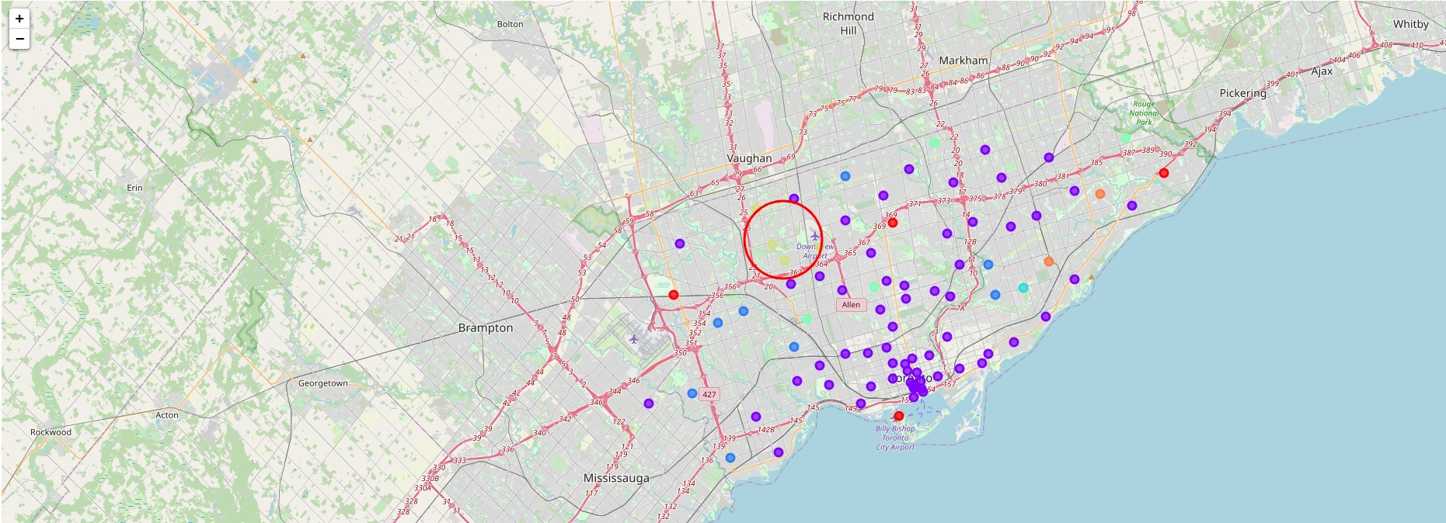
Analysis

Slide 8
Analysis
By looking at the low density clusters and the map plot of the neighborhoods a clear group of low population and geographically close neighborhoods is formed in the cluster 5.

Slide 9
Results and Discussion
As we look at the data, a well defined area on the map is formed by cluster 5. Its low density and low population makes it a really good starting point of application for the government stimulus. The best neighborhood being Downsview in North York, were the postal code of “ M3K “ is the prime location to begin.

Slide 10
Conclusion
I feel confident with the recommendation in this area as it is backed up with demonstrated data analysis. While nothing can ever be certain I am certain that it is a great neighborhood to receive the government incentives.
Much more inference can be obtained with more work, so that the rollout of the stimulus can be most efficient.

